Slide 1
Nutanix Calm Deployment über Hybrid/Public-Cloud Grenzen hinweg
Thomas Findelkind
Senior Solution Architect

Slide 2
Pioneering the Enterprise Cloud OS
Enterprise Cloud
HCI++
Hyperconverged Infrastructure
Container Support
Native Virtualization
Cloud Automation
Integrated Compute & Storage
Multi-hypervisor Support
Application Mobility
Hybrid-cloud Services
VM-centric Storage
Integrated Public Cloud
Machine Intelligence
Backup & DR Services
Microsegmentation*
Systems and Operations Management
Application Ecosystem
File and Block Storage
Object Storage*
Notes:
Our journey to developing the enterprise cloud has resulted in our development of a broad set of services and functionality for our customers
Our more recent developments around cloud automation, application mobility, container support and network segmentation allow our customers to experience ROI and performance benefits unmatched by our competition
While the attractiveness of the market we have helped foster has significantly increased in size, we have seen several new competitors
The competitors are early in a multi-year journey towards the enterprise cloud

Slide 3
Managing Apps Is Increasingly Challenging
More app components and platforms
Increased response time and finger pointing
App
App
App
Knowledge silos
Longer time to resolution
Virtualization
Compute/storage
Fragmented ownership
Longer release cycles
Private Cloud
Notes:
Businesses constantly seek to improve overall IT agility and responsiveness to enable more rapid innovation. However, application development and delivery is growing in complexity, making it challenging for teams to keep up with increasing expectations to move faster. Siloed organizations and processes disrupt one another, resulting in cross-discipline overhead and slower ability to deliver business value.
More components
Multiple tools
Knowledge silos
Fragmented ownership
Frequent releases
Multiple platforms
Rise of microservices
Revisions, OS platforms
Revision Control
reliance on manual processes does not scale
rely on a small number of individuals,
growing number of interdependent components,
leading to frequent configuration errors and unplanned downtime

Slide 4

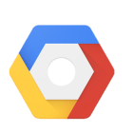
Hybrid Clouds Add Another Layer of Challenges
Inoperable and Disparate Platforms
Application
Management and Provisioning
Private Cloud
Infrastructure
Notes:
Inoperable and Disparate Platforms

Slide 5
What Is Needed
Full-stack Application
Automation
Application
Unified Orchestration and Management
Management and Provisioning
IAM Console
Azure Portal or Classic Portal
GCP Console
Private Cloud
Infrastructure

Slide 6

Introducing Calm
Nutanix Calm
Application
Management and Provisioning
Infrastructure

Slide 7
Delivered in Prism
Prism
Acropolis
Calm
One-click Infrastructure Management
App Mobility Fabric
App Lifecycle Management
One-click Operational Insights
Distributed Storage Fabric
Self Service and Governance
Hybrid Cloud Management
One-Click Planning
AHV (Built-in Virtualization)

Slide 8
Calm Overview
Calm
Application Lifecycle Automation
Self Service and Governance
Hybrid Cloud Management

Slide 9
Application Lifecycle Automation
Calm
Application Lifecycle Automation
Self Service and Governance
Hybrid Cloud Management

Slide 10
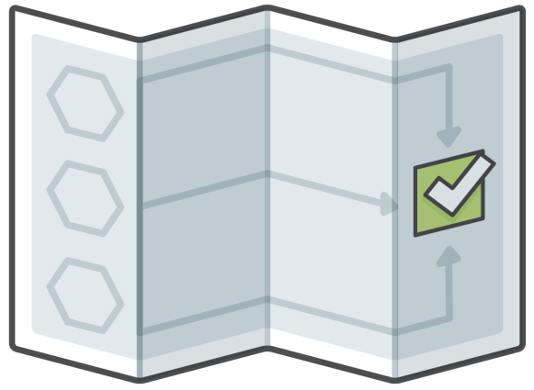
Blueprints Capture All Elements Of The Application
Component
Policy
VMs
Security
Base Applications
Connectivity
Configuration
Dependencies
Blueprint
Network
Operations
Intuitive and visual way to model applications
Incorporate all elements including VMs, configurations and binaries
Drive repeatable provisioning of applications

Slide 11
Blueprints Are Used For Lifecycle Management
Provision
Delete
Automate routine application management operations
Reduce errors, delays and downtime
Configure
Blueprint
Upgrade
Scale

Slide 12
Make Sense of Complexity
Capture organizational knowledge
Streamline complex provisioning and lifecycle tasks
Easy to understand dependencies

Slide 13
Self Service and Governance
Calm
Application Lifecycle Automation
Self Service and Governance
Hybrid Cloud Management

Slide 14

Nutanix Marketplace Empowers Self-Service
Consume pre-integrated blueprints
Publish blueprints to enable self-service

Slide 15
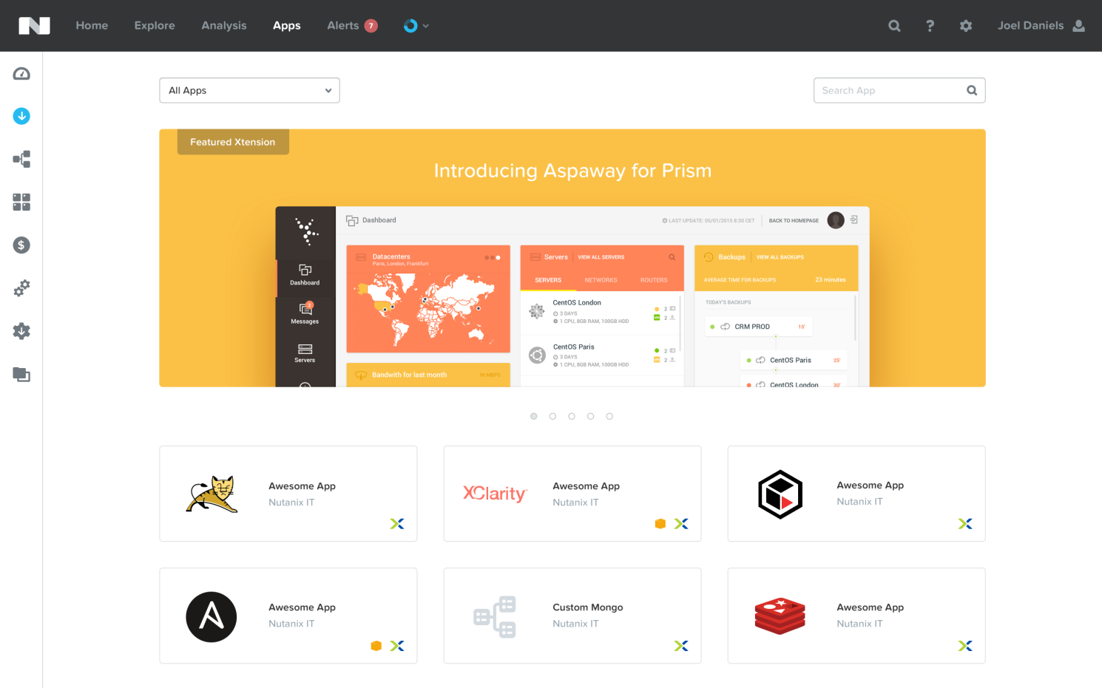

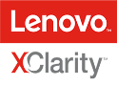



Nutanix Marketplace Empowers Self-Service
One-Click App Provisioning
Pre-integrated blueprints
Self-service based on user role and group
Notes:
Blueprints can be published directly to end users through the Nutanix Marketplace, giving application owners and developers the ability to request IT services that can then be instantly provisioned.
Calm provides powerful, application-centric self-service capabilities, while maintaining control with role-based governance that limits user operations based on user role, such as IT operator, developer or managers for approval. Additionally, all critical activities and changes are logged for end-to-end traceability, aiding security teams with key compliance initiatives.
Example: Enable employees in the development team to create, scale and destroy dev/test environments without the need to file IT ticket requests. Development teams benefit from rapid provisioning times, while IT maintains control, traceability of user operations and visibility into resource consumption.
IT Governance - Calm maintains control with role-based governance that limits user operations based on permissions. Additionally, all activities and changes are centrally logged for end-to-end traceability, aiding security teams with key compliance initiatives.

Slide 16

Governance and Control
Granular Access Controls and Budgets
Engineering
Sales
Frictionless Service Delivery
Nutanix Marketplace
Finance
Manufacturing

Slide 17


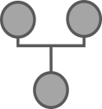
Transitioning From Friction And Handoffs..
IT Resource Request
OS Team
DB Team
Network Team
Handoffs:
Different SLAs
Different Priorities
Different Approvals
Ticket Creation

Slide 18

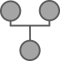
..To One Click Automation
Provision VM
Connect DB
Configure Network
IT User
Request
Marketplace
Finalize App
Automation

Slide 19
Hybrid Cloud Management
Calm
Application Lifecycle Automation
Self Service and Governance
Hybrid Cloud Management

Slide 20

Deploy Across Clouds Based On Need
Calm
Apps
Enterprise Cloud
Public clouds
Notes:
Automate the provisioning of Hybrid Cloud architectures, scaling both multi-tiered and distributed applications across different cloud environments, including AWS.

Slide 21
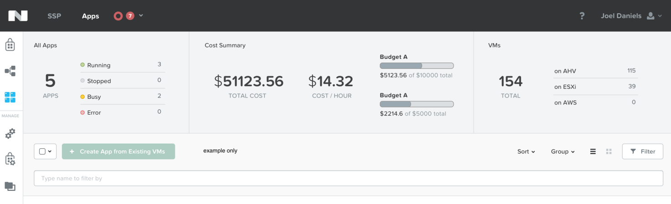

Understand The True Cost Of Public Clouds
screenshot
Understand the true cost of hybrid cloud deployments
Enterprise Cloud
Public Clouds
Notes:
Calm’s shows the overall utilization and true cost of your public cloud consumption at a glance so that decisions are based on business needs and budget requirements

Slide 22




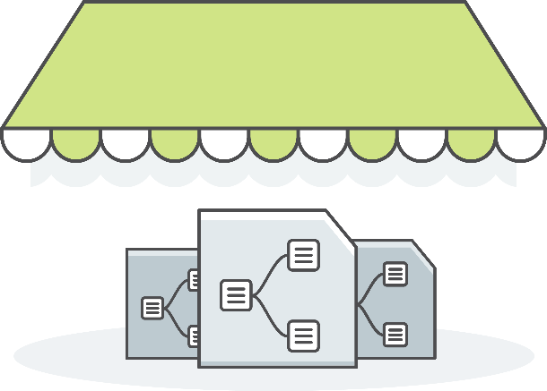











Marketplace
Admin

